Slide 1

Optoelectronic and photonic
devices based on
transition metal dichalcogenides (TMDC's)
Esat Canberk Özçelik

Slide 2
Mechanisms in Optoelectronic Devices
Photoconduction (PC)
Photogating (PG)
Persistent photocurrent (PPC)
Avalanche photodetectors (APD)
Photovoltaics (PV)
Electroluminescence (EL)
…

Slide 3
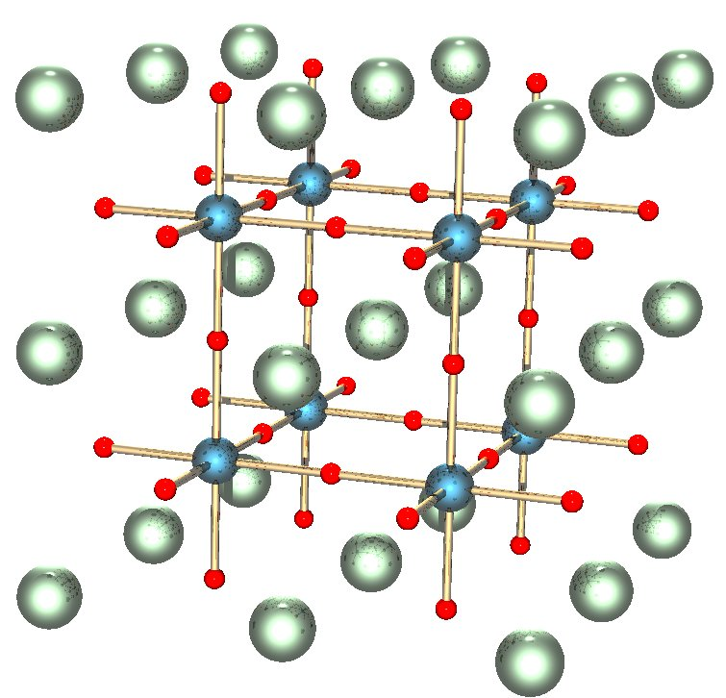
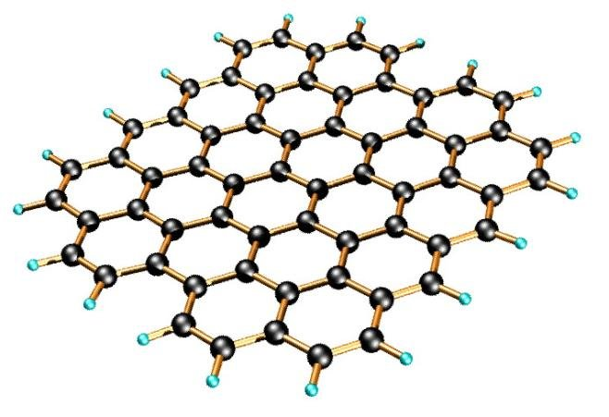
Structures used in Optoelectronics (3D – 2D)
Perovskite Structure (ABX₃)
Graphene Structure

Slide 4
2 Dimensioned Materials
Pros
Excellent Optical and Electrical Properties
High Absorption for Wavelengths Near Bandgap
Higher Internal Quantum Efficiency
Can be vertically stacked (by Van der Waals bonds)
High Transparency
Flexibility and Lightweight
High Quantum Yield and Stability
Doesn’t posses dangling bonds
Cons
Weak Light Absorption Due to Atomic Scale Thickness
Fabrication Challenges Hinder Practical Applications
Lack of Scalability in Fabrication Method
Limited Power Generation with Low Open-Circuit Voltages
Lack of Synergy Between 2D Community and Conventional Solar Community

Slide 5
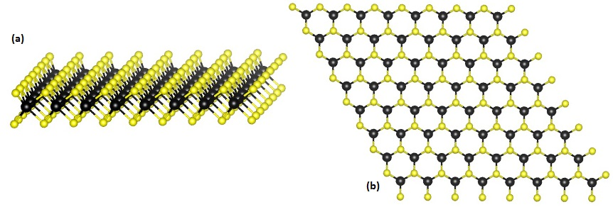
What are
transition metal dichalcogenides (TMDC's)?

Slide 6
What are
transition metal dichalcogenides (TMDC's)?
MX₂
M: Transition metal element (IV – VII B)
X: Chalcogen

Slide 7
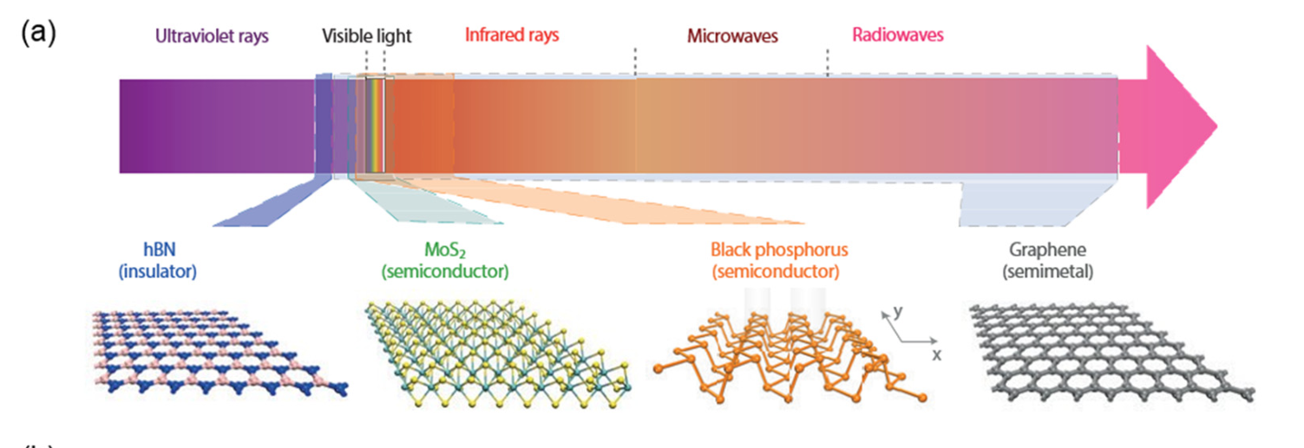
Lee, J.Y.; Shin, J.-H.; Lee, G.-H.; Lee, C.-H. Two-Dimensional Semiconductor Optoelectronics Based on van der Waals Heterostructures. Nanomaterials 2016, 6, 193. https://doi.org/10.3390/nano6110193

Slide 8
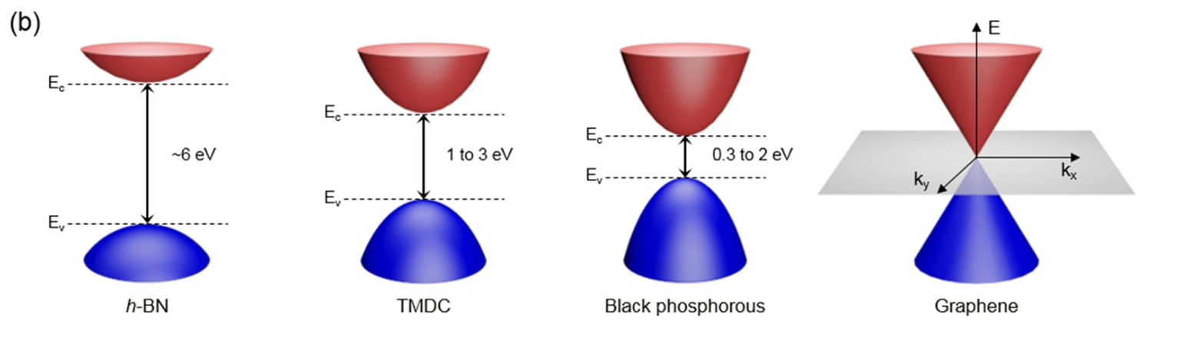
Lee, J.Y.; Shin, J.-H.; Lee, G.-H.; Lee, C.-H. Two-Dimensional Semiconductor Optoelectronics Based on van der Waals Heterostructures. Nanomaterials 2016, 6, 193. https://doi.org/10.3390/nano6110193

Slide 9
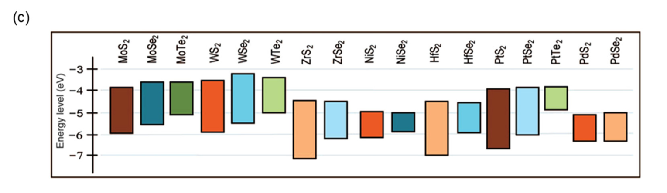
Lee, J.Y.; Shin, J.-H.; Lee, G.-H.; Lee, C.-H. Two-Dimensional Semiconductor Optoelectronics Based on van der Waals Heterostructures. Nanomaterials 2016, 6, 193. https://doi.org/10.3390/nano6110193

Slide 10
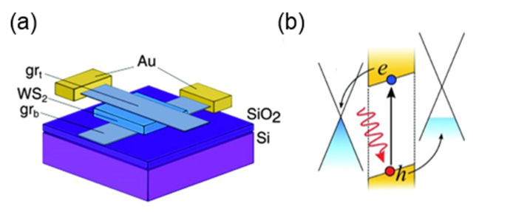
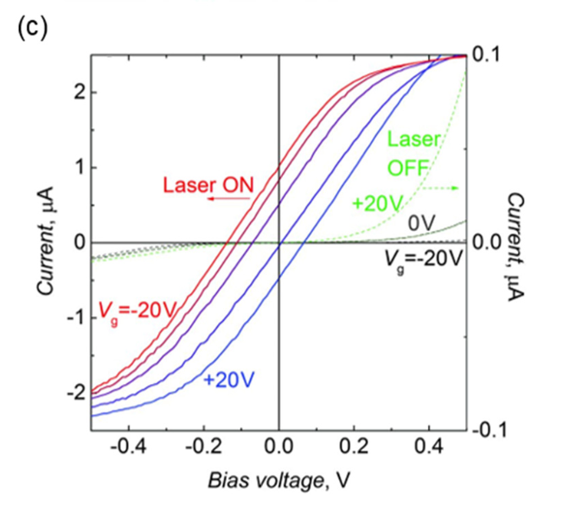
Optoelectronics Based on 2D Semiconductor Heterostructures
Photodetection
Photodetection apparatus utilizing a 2D van der Waals heterostructure consisting of graphene/ WS₂ /graphene: (a) Depiction in a schematic form; (b) representation of band alignment; and (c) analysis of photoresponse features with respect to the gate voltages.

Slide 11
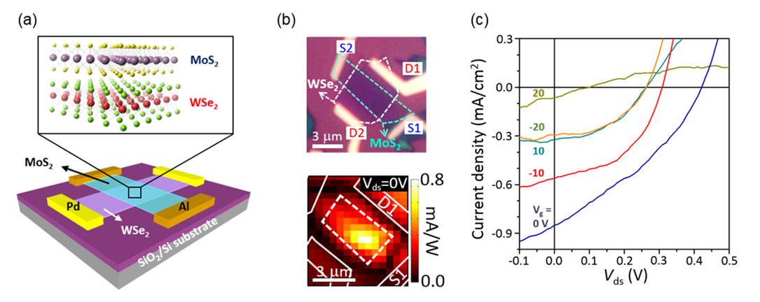
Optoelectronics Based on 2D Semiconductor Heterostructures
Atomically Thin p-n Heterojunctions Based on Semiconducting TMDCs
Gate-modulated photovoltaic response in a thin p-n heterojunction. (a) Schematic of MoS2/ WSe₂ vdW-stacked device with lateral metal contacts; (b) Optical image and photocurrent map for Vds = 0 V, 532 nm laser; (c) Photoresponse at different gate voltages under white-light.

Slide 12
Optoelectronics Based on 2D Semiconductor Heterostructures
Atomically Thin p-n Heterojunctions Based on Semiconducting TMDCs
Exhibits gate-tunable diode behaviours
PV responses mostly originates at the heterojunction
Extended depletion region and carrier diffusion are absent in contrast to conventional p-n junctions
Thus ultrafast charge transfer can be expected
Hong et al. University of California at Berkeley reported charge transfers at a rate of ~50 femtoseconds in the MoS_{2/}WS₂

Slide 13
Optoelectronics Based on 2D Semiconductor Heterostructures
Interlayer Tunneling
Despite efficient charge separation, electrons and holes may recombine through interlayer processes and quantum tunnelling due to spatial confinement within adjacent 2D atomic planes.
    Langevin recombination driven by Coulomb Interaction
    Shockley–Read–Hall recombination mediated by trap states present in the middle of the bandgap

Slide 14
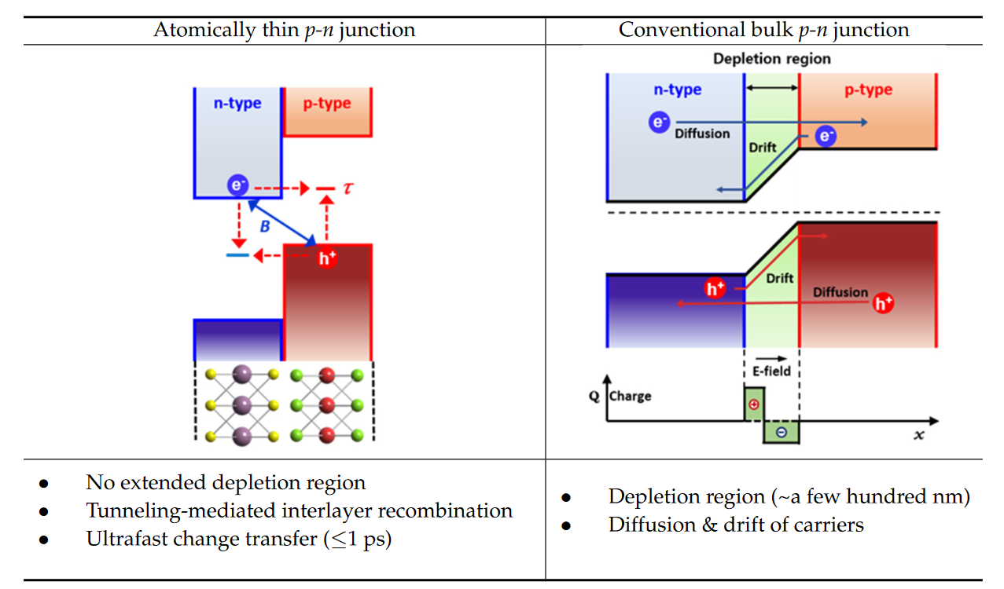
Lee JY, Shin J-H, Lee G-H, Lee C-H. Two-Dimensional Semiconductor Optoelectronics Based on van der Waals Heterostructures. Nanomaterials. 2016; 6(11):193. https://doi.org/10.3390/nano6110193

Slide 15
Optoelectronics Based on 2D Semiconductor Heterostructures
Interlayer Tunneling
The interlayer-tunneling-mediated recombination process, which is prohibited in bulk p-n junctions, decreases the quantum efficiency of photon-to-electron conversion.
To address the recombination issue, an all-2D-vdW heterostructure consisting of a graphene/MoS2/WSe2/graphene stack has been proposed

Slide 16
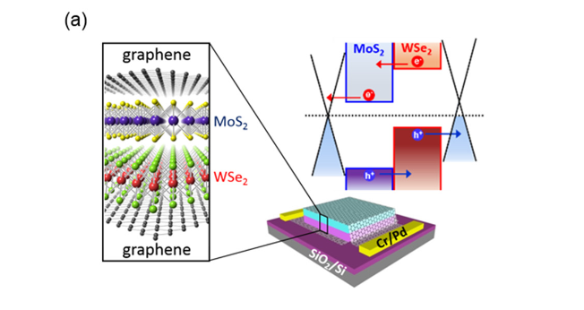
Optoelectronics Based on 2D Semiconductor Heterostructures
Interlayer Tunneling
Excitons dissociate and carriers extract rapidly via quantum tunnelling
Swift extraction suppresses recombination, boosting photoconversion efficiency
Vertical all-2D-vdW structures hint at applications in high-efficiency photovoltaics and ultrafast photodetectors

Slide 17
Optoelectronics Based on 2D Semiconductor Heterostructures
Light Emitting Devices
Direct bandgap semiconductors are crucial due to,
  Higher quantum efficiency
  Large exciton binding energy -> enhancement of radiative recombination rate
These properties allows the fabrication of ultrathin 2D light emitters with high efficiency

Slide 18
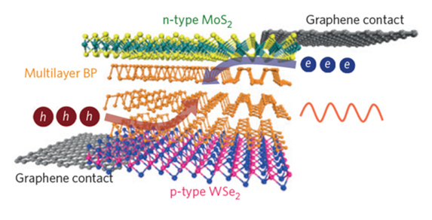
Optoelectronics Based on 2D Semiconductor Heterostructures
Light Emitting Devices
The recently suggested infrared light-emitting diodes (LEDs) utilize 2D van der Waals (vdW) heterostructures with black phosphorous serving as the emission layer.
Xia, F.; Wang, H.; Xiao, D.; Dubey, M.; Ramasubramaniam, A. Two-dimensional material nanophotonics.
Nat. Photonics 2014, 8, 899–907

Slide 19
References
*Lee JY, Shin J-H, Lee G-H, Lee C-H. Two-Dimensional Semiconductor Optoelectronics Based on van der Waals Heterostructures. Nanomaterials. 2016; 6(11):193. https://doi.org/10.3390/nano6110193
*Kartikey Thakar and Saurabh Lodha 2020 Mater. Res. Express 7 014002 DOI 10.1088/2053-1591/ab5c9c
*Britnell, L., Ribeiro, R. M., Eckmann, A., Jalil, R., Belle, B. D., Mishchenko, A., Kim, Y.-J., Gorbachev, R. V., Georgiou, T., Morozov, S. V., Grigorenko, A. N., Geim, A. K., Casiraghi, C., Castro Neto, A. H., & Novoselov, K. S. (2013). Strong Light-Matter Interactions in Heterostructures of Atomically Thin Films. Science, 340(6138), 1311-1314. DOI: 10.1126/science.1235547
*Jiaqiang, Nie., Jiancan, Yu., Wenxing, Liu., Tianbao, Yu., Pingqi, Gao. (2020). Ultra-narrowband perfect absorption of monolayer two-dimensional materials enabled by all-dielectric subwavelength gratings. Optics Express, doi: 10.1364/OE.413032
*Dong, Liu., Qiang, Li. (2017). Sub-nanometer planar solar absorber. Nano Energy, doi: 10.1016/J.NANOEN.2017.02.027
*Sonali, Das., Deepak, Pandey., Jayan, Thomas., Tania, Roy. (2019). The Role of Graphene and Other 2D Materials in Solar Photovoltaics.. Advanced Materials, doi: 10.1002/ADMA.201802722
(2022). 2D Materials for Photovoltaics. doi: 10.1007/978-981-16-4480-1_28-1
*Malkeshkumar, Patel., Thanh, Tai, Nguyen., Mohit, Kumar., Dong-Kyun, Ban., Dongyeun, Won., Mali, Zhao., Joondong, Kim., Yu, Kwon, Kim., Heejun, Yang., Ching-Ping, Wong. (2020). 2D layer-embedded transparent photovoltaics. Nano Energy, doi: 10.1016/J.NANOEN.2019.104328
*Xia, F.; Wang, H.; Xiao, D.; Dubey, M.; Ramasubramaniam, A. Two-dimensional material nanophotonics.
Nat. Photonics 2014, 8, 899–907

