Slide 1
Quantum Computing
Ege Akman – 1729970
Emir Tolga Demirel – 1730198
Esat Canberk Özçelik - 1805100
Kaan Kocatürk - 1728808
İren Su Dülger - 1804907

Slide 2
Project Topic
This project is about using Raspberry Pi to simulate entanglement and superposition using Qiskit library and showing the results on SenseHAT 8x8 LED by bar graph.

Slide 3
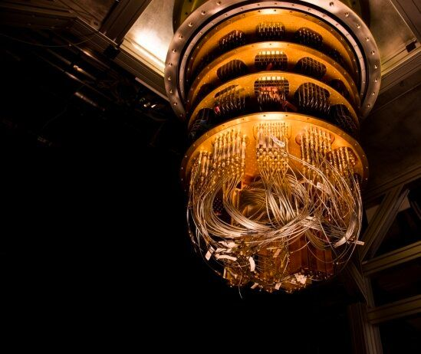
What is Quantum Computing?
Quantum computing is a type of computation that uses the collective features of quantum states to accomplish calculations, such as superposition, interference, and entanglement. Quantum computers are machines that can do quantum computing.
Google quantum computer

Slide 4
Quantum computing vs Classical computing
Classical computers manipulate ones and zeroes to crunch through operations, but quantum computers use quantum bits or qubits. Just like classical computers, quantum computers use ones and zeros, but qubits have a third state called “superposition” that allows them to represent a one or a zero at the same time.
Qubits can be prepared in a superposition of an exponential number of states.Hence Quantum computers can compute way more states at the same time than the regular computer.

Slide 5
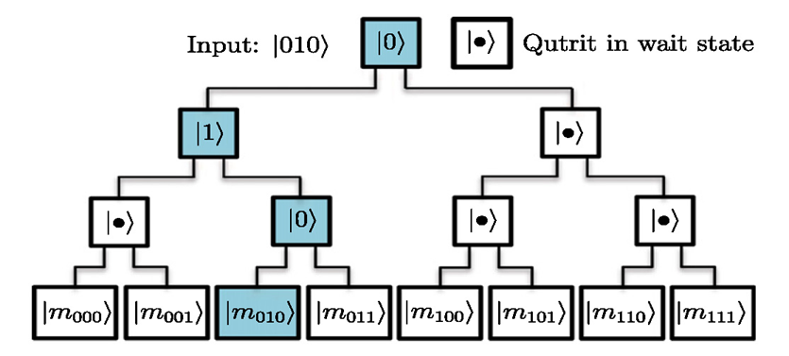
Quantum Memory (QRAM)
•In quantum computing, quantum memory is the quantum-mechanical version of ordinary computer memory. Whereas ordinary memory stores information as binary states (represented by "1"s and "0"s), quantum memory stores a quantum state for later retrieval. These states hold useful computational information known as qubits.

Slide 6
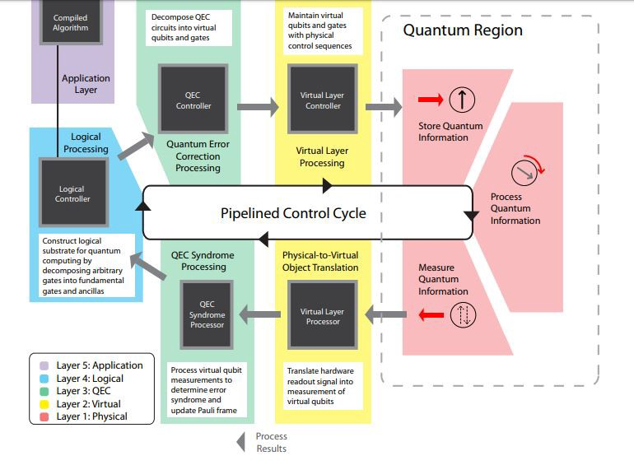
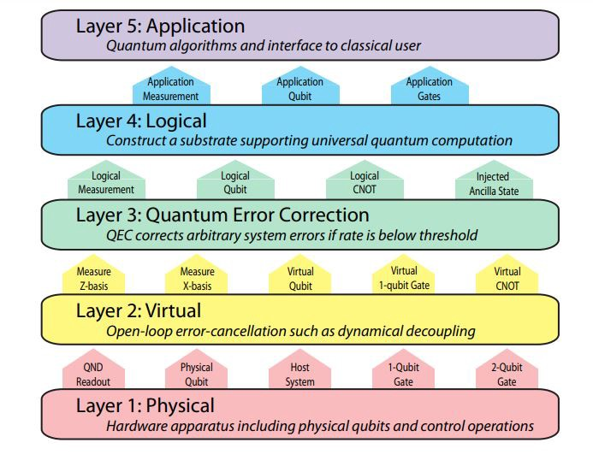
Architecture Of A Quantum Computer
The architecture of Quantum computer has 5 layers. To execute an operation, a layer must get the command or instructions from the layer below and process it accordingly.

Slide 7
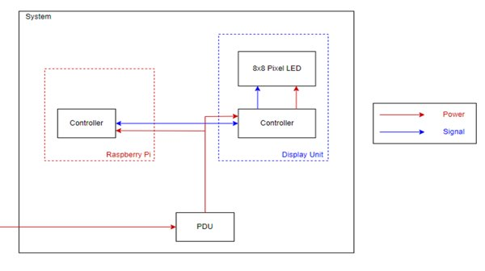
System Design
Raspberry Pi
SenseHAT 8x8 pixel LED

Slide 8
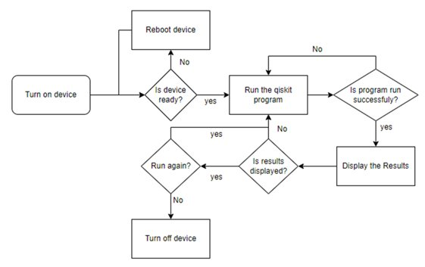
The Process of System
Flow Chart of The System.
Turn on device
Check is device ready
Run Qiskit program
Display results
Close or rerun the program

Slide 9
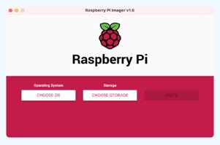

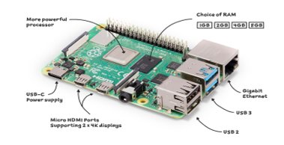


Device Setup
Raspberry Pi Imager
SSH configuration
Updating repository & upgrading packages
IMAGER
Raspberry Pi 4

Slide 10



Device Setup
Installing Qiskit and jupyter-notebook
Connection to jupyter notebook.

Slide 11
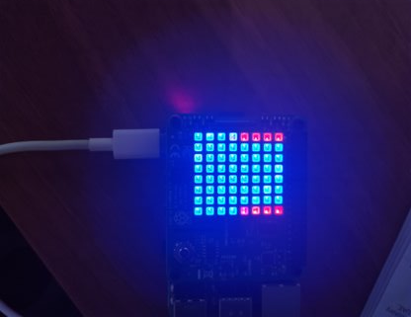
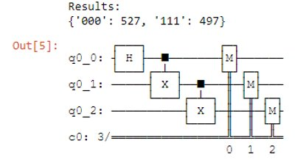
Materialization & Verification
Creating quantum circuits using Qiskit.
Displaying results using SenseHAT LED on Raspberry Pi.
Hardwares tested by executing simple codes.
Qiskit results are compared with the mathematical results.
3 Qubit Entanglement
3 Qubit Entanglement Qiskits Circuit and Results.

Slide 12
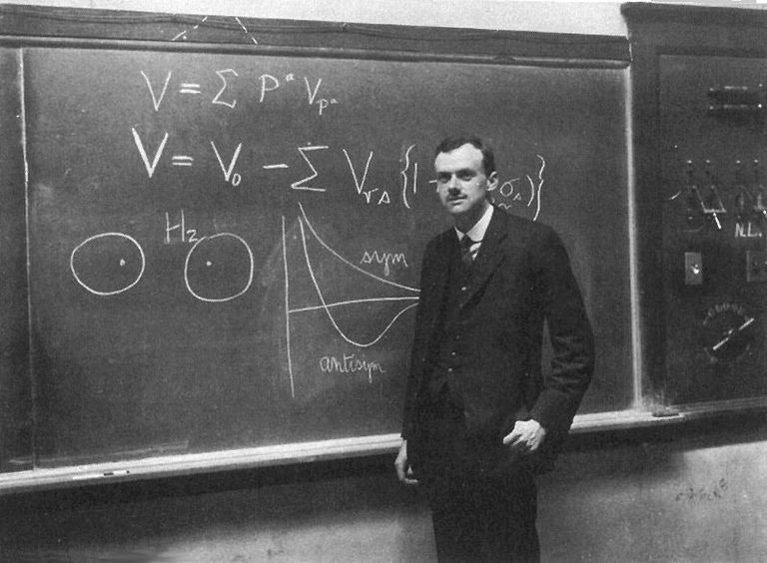
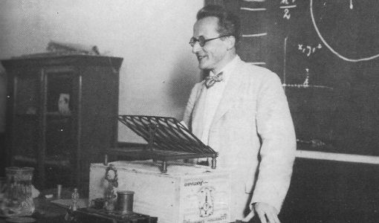
Materialization & Verification
Superposition

Slide 13

Materialization & Verification
Physical System of a Qubit
(Dirac Notation)

Slide 14
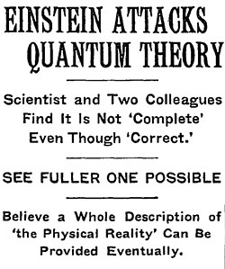
Materialization & Verification
Quantum Entanglement

Slide 15
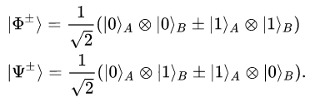
Materialization & Verification
Entangled Bell States

Slide 16
Quantum Programming
  Classical Computer with n bits
  1st bit — 1 state (0 or 1)
  2nd bit — 1 state
  nth bit — 1 state
  Computer's state = 1^n =1
  Quantum Computer with n Qubits
  1st bit - 2 states (Both 0 & 1)
  2nd bit - 2 states
  nth bit - 2 states
  Computer's state = 2^n
  Outcomes of spinning two coins
  Physical World
  HH, TT, HT, TH
  With Quantum Entanglement
  HH, TT

Slide 17
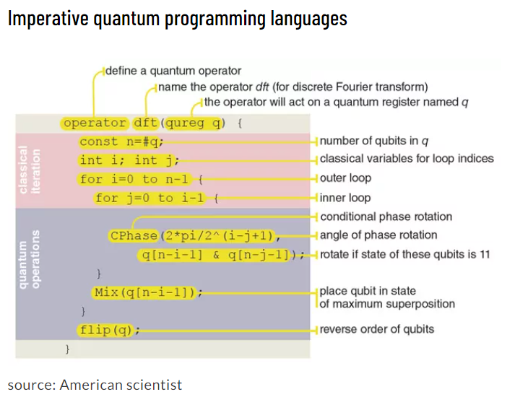
Progress of Quantum Programming
QCL: Quantum Computing Language, one of the first implemented quantum programming languages. It resembles C language in regards of syntax and data types.
QMASM: Quantum Macro Assembler, published in 2016. It is a low-level language specific to quantum annealing. The significance of QMASM is that it relieves the programmer from having to know system-specific hardware details while still allowing programs to be expressed at a low level of abstraction.
Silq is originally published in 2020. Silq is a high-level programming language written in D language which has 482 stars and 10 contributors on github and is regularly updated as of 2021.

Slide 18
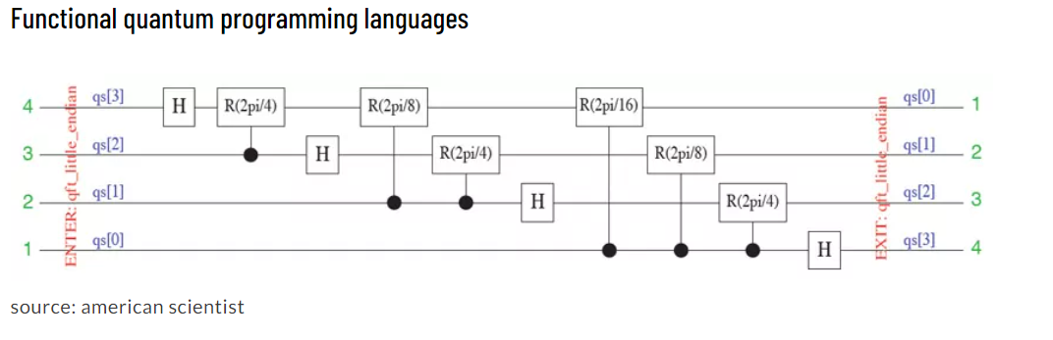
Progress of Quantum Programming
QML: published in 2007, a Haskell-like quantum programming language based on strict linear logic. It can integrate reversible and irreversible quantum computations
Quantum Lambda Calculus: it is based on classical lambda calculus introduced in 1930 and was first defined for quantum calculations in 1996. It uses high-order functions (λx.x^3) Therefore, it is stronger than the standard quantum computational models, such as quantum Turing machine or the quantum circuit model.
QFC and QPL: Semantically QFC and QPL are equivalent. However, in QFC, quantum programs are represented using flowchart syntax, but in QPL syntactic structure of quantum programs are represented using textual representations.

Slide 19
Qiskit Framework
Qiskit is comprised of four different elements
  Terra: Composing quantum programs at the level of circuits and pulses
  Aer: Accelerating development via simulators, emulators, and debuggers
  Aqua: Addressing noise and errors
  Ignis: Building algorithms and applications

Slide 20
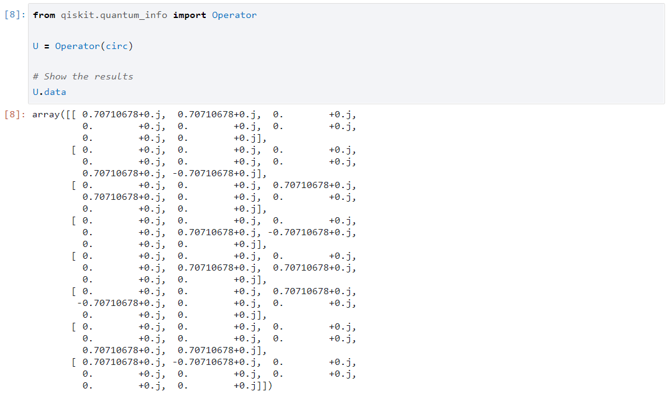
Representation of Quantum Circuit

Slide 21
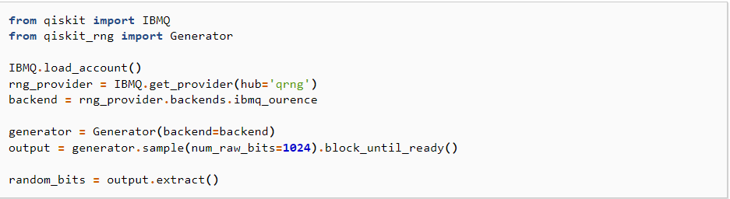
Qiskit RNG
Qiskit RNG is a collaboration between Cambridge Quantum Computing (CQC) and IBM Quantum for generating certified quantum randomness using IBM Quantum systems running three-qubit GHZ states with random X- and Y-measurements.

Slide 22
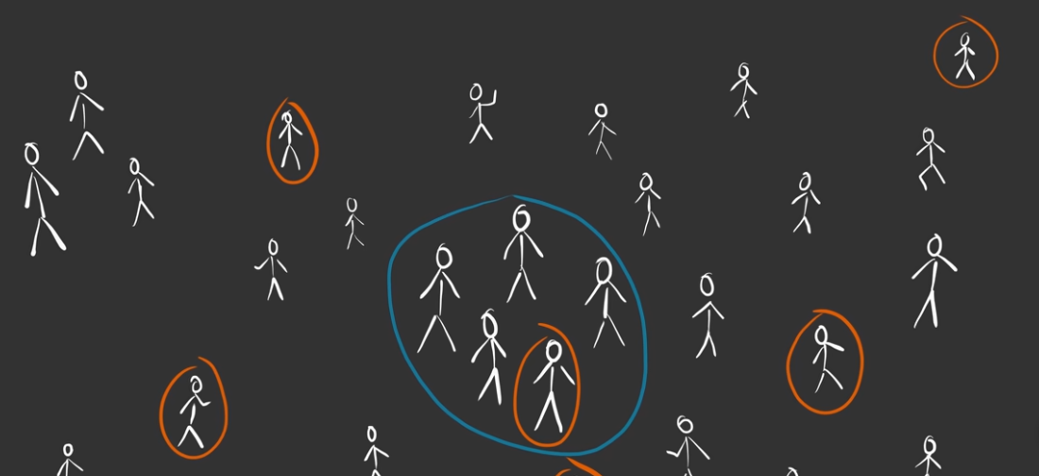
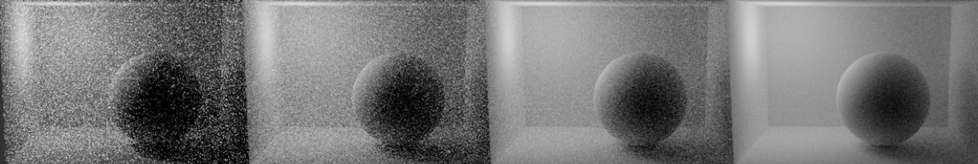
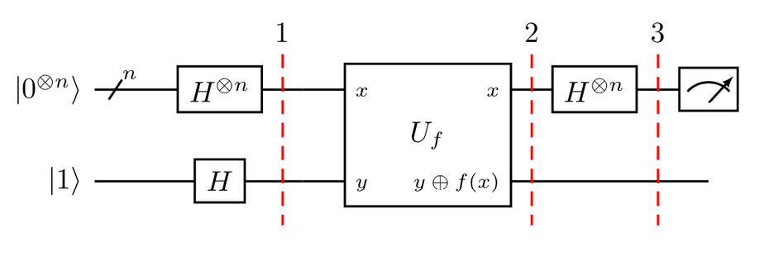
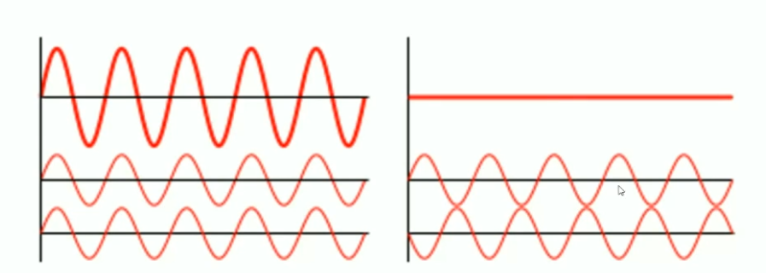
Monte Carlo
Deutsch-Jozsa

Slide 23
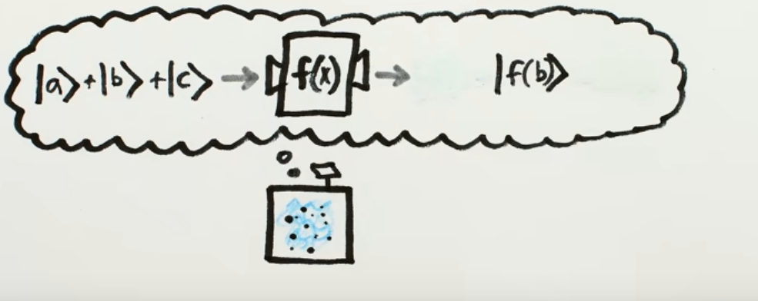
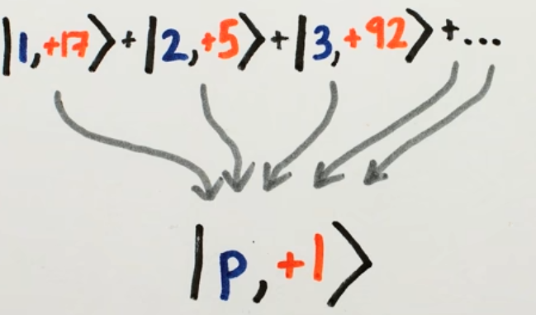
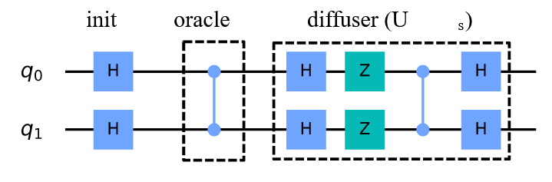
Shor's algorithm
Grover's algorithm

Slide 24
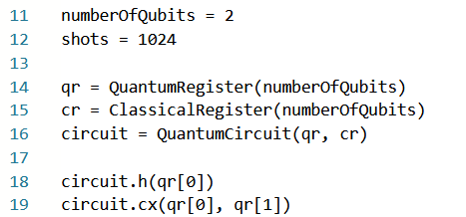
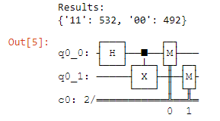
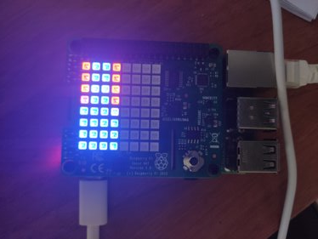

1- Two Qubit Entanglement
Quantum Circuit :
Writing to the SenseHat pixels :

Slide 25
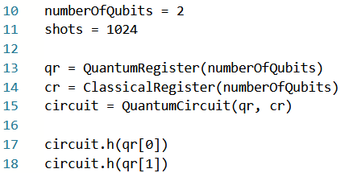
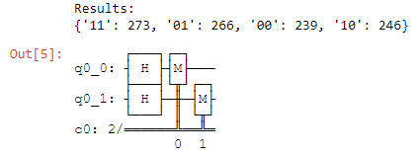
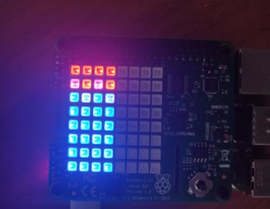

2- Two Qubit SuperPosition
Create quantum Circuit :
Writing to the SenseHat pixels :

Slide 26
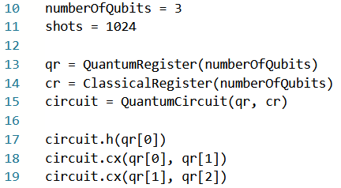
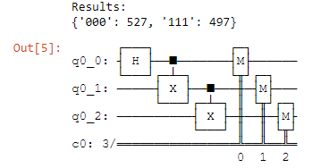
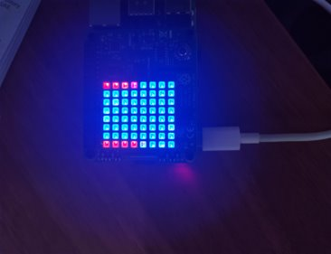
3- Three Qubit Entanglement
Create quantum Circuit :
Writing to the SenseHat pixels :

Slide 27
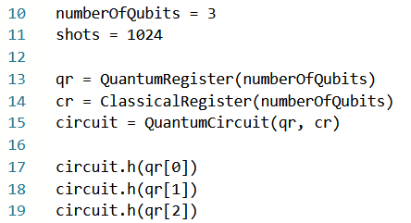
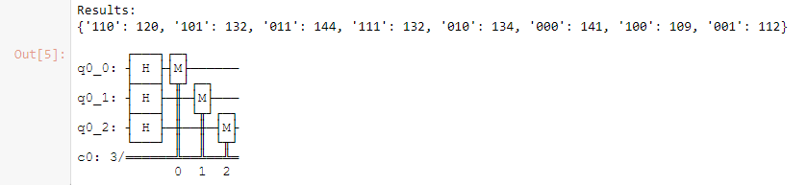
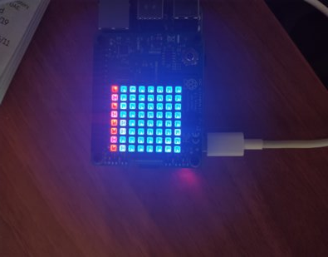
4- Three Qubit SuperPosition
Create quantum Circuit :
Writing to the SenseHat pixels :

Slide 28

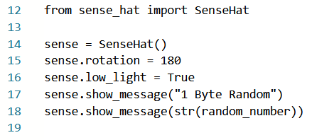
Random Number Generator
qRNG connects to IBMQ and generate some numbers:
random generated number is shown in the rasqberry :

Slide 29
Conclusion (Electrical & Electronics Eng.)
Electrical and Electronics Engineering students have understood the fundamentals of quantum computing.
Electrical and Electronics Engineering students have understood how quantum computers work.

Slide 30
Conclusion
Computer Engineering
Implementing projects on Raspberry Pi
Implementation of the Quantum Circuits on Raspberry Pi
Implementing Random Number Generator
General understanding of implementation and working principle of quantum circuits on a computer-based environment.

